Slide 1



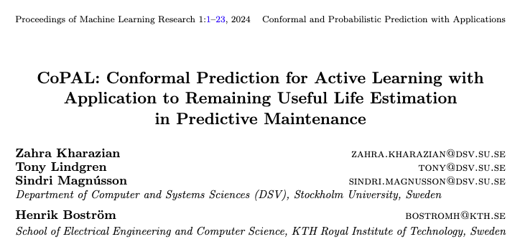

Slide 2


CoPAL’s Motivation:
(Active Learning)
VS
Humans optimize their decisions over time ≠ ML
ML need human-in-the-loop (AL)
It improves the model’s performance by experiencing and retraining.
Assumption: not all of the samples are equally informative for model improvement.
Model agnostic

Slide 3
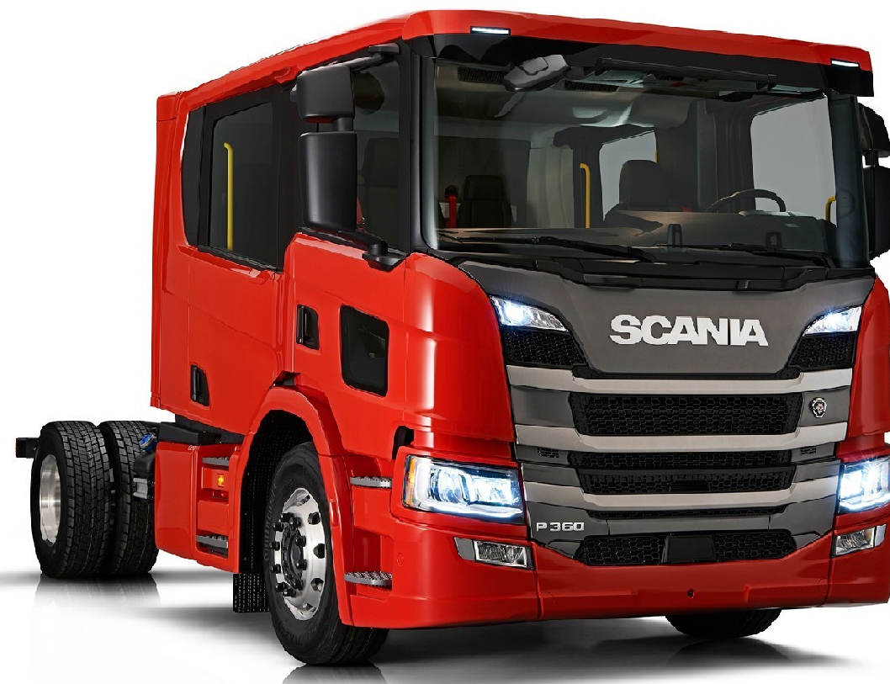
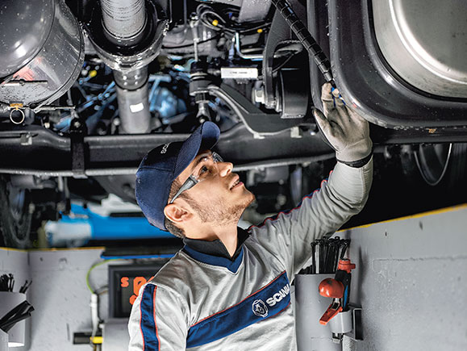

CoPAL’s Motivation:
(Conformal Prediction in Active Learning in Predictive Maintenance)
ML
ML
train
time
RUL
test
RUL
RUL
RUL
RUL
Remaining Useful life (RUL) estimation
To train a ML model: Need a large volume of data with labels/true RUL
For decision optimization: Not feasible to send all vehicles to workshops for RUL estimation (time and resource-consuming)
Need a more strategic approach for selecting vehicles for RUL estimation that optimizes resource utilization and maximizes the effectiveness of PdM efforts.
Steps:
  Initialization
  Model training
  Sample selection
    (query strategy: Uncertainty sampling)
  Feedback
  Model update

Slide 4
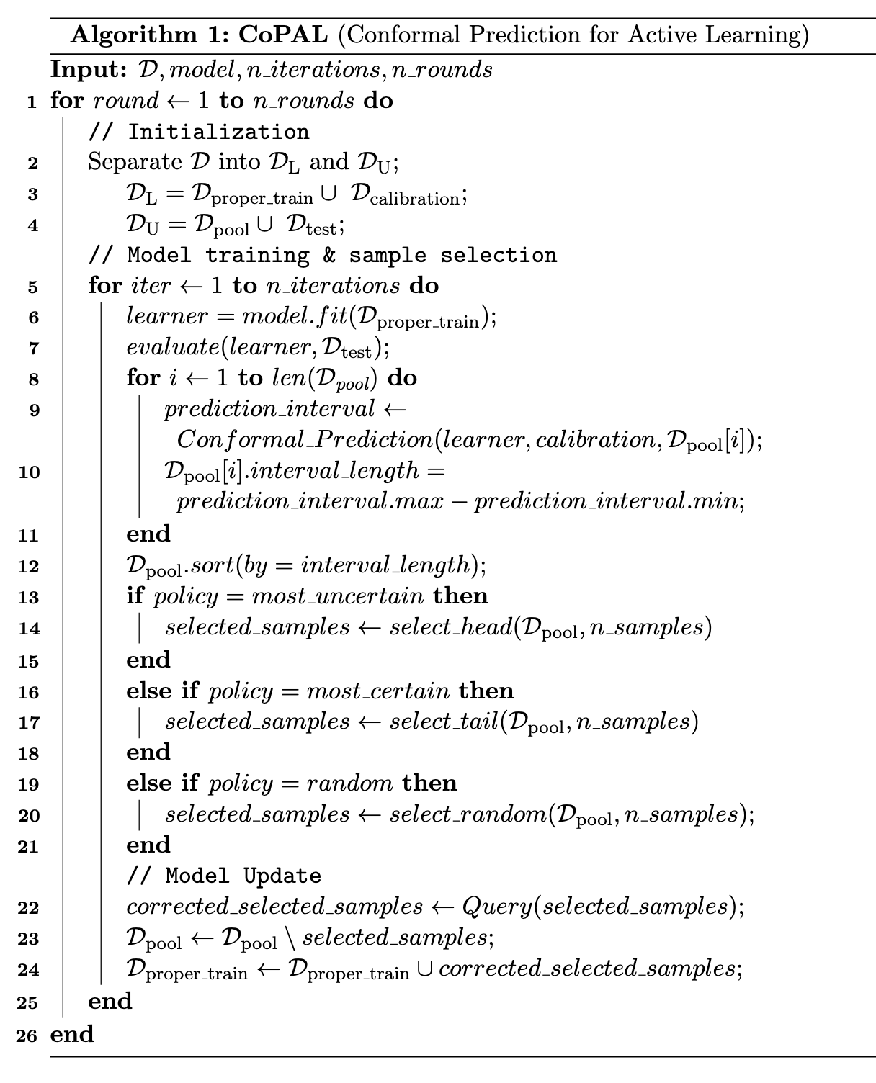
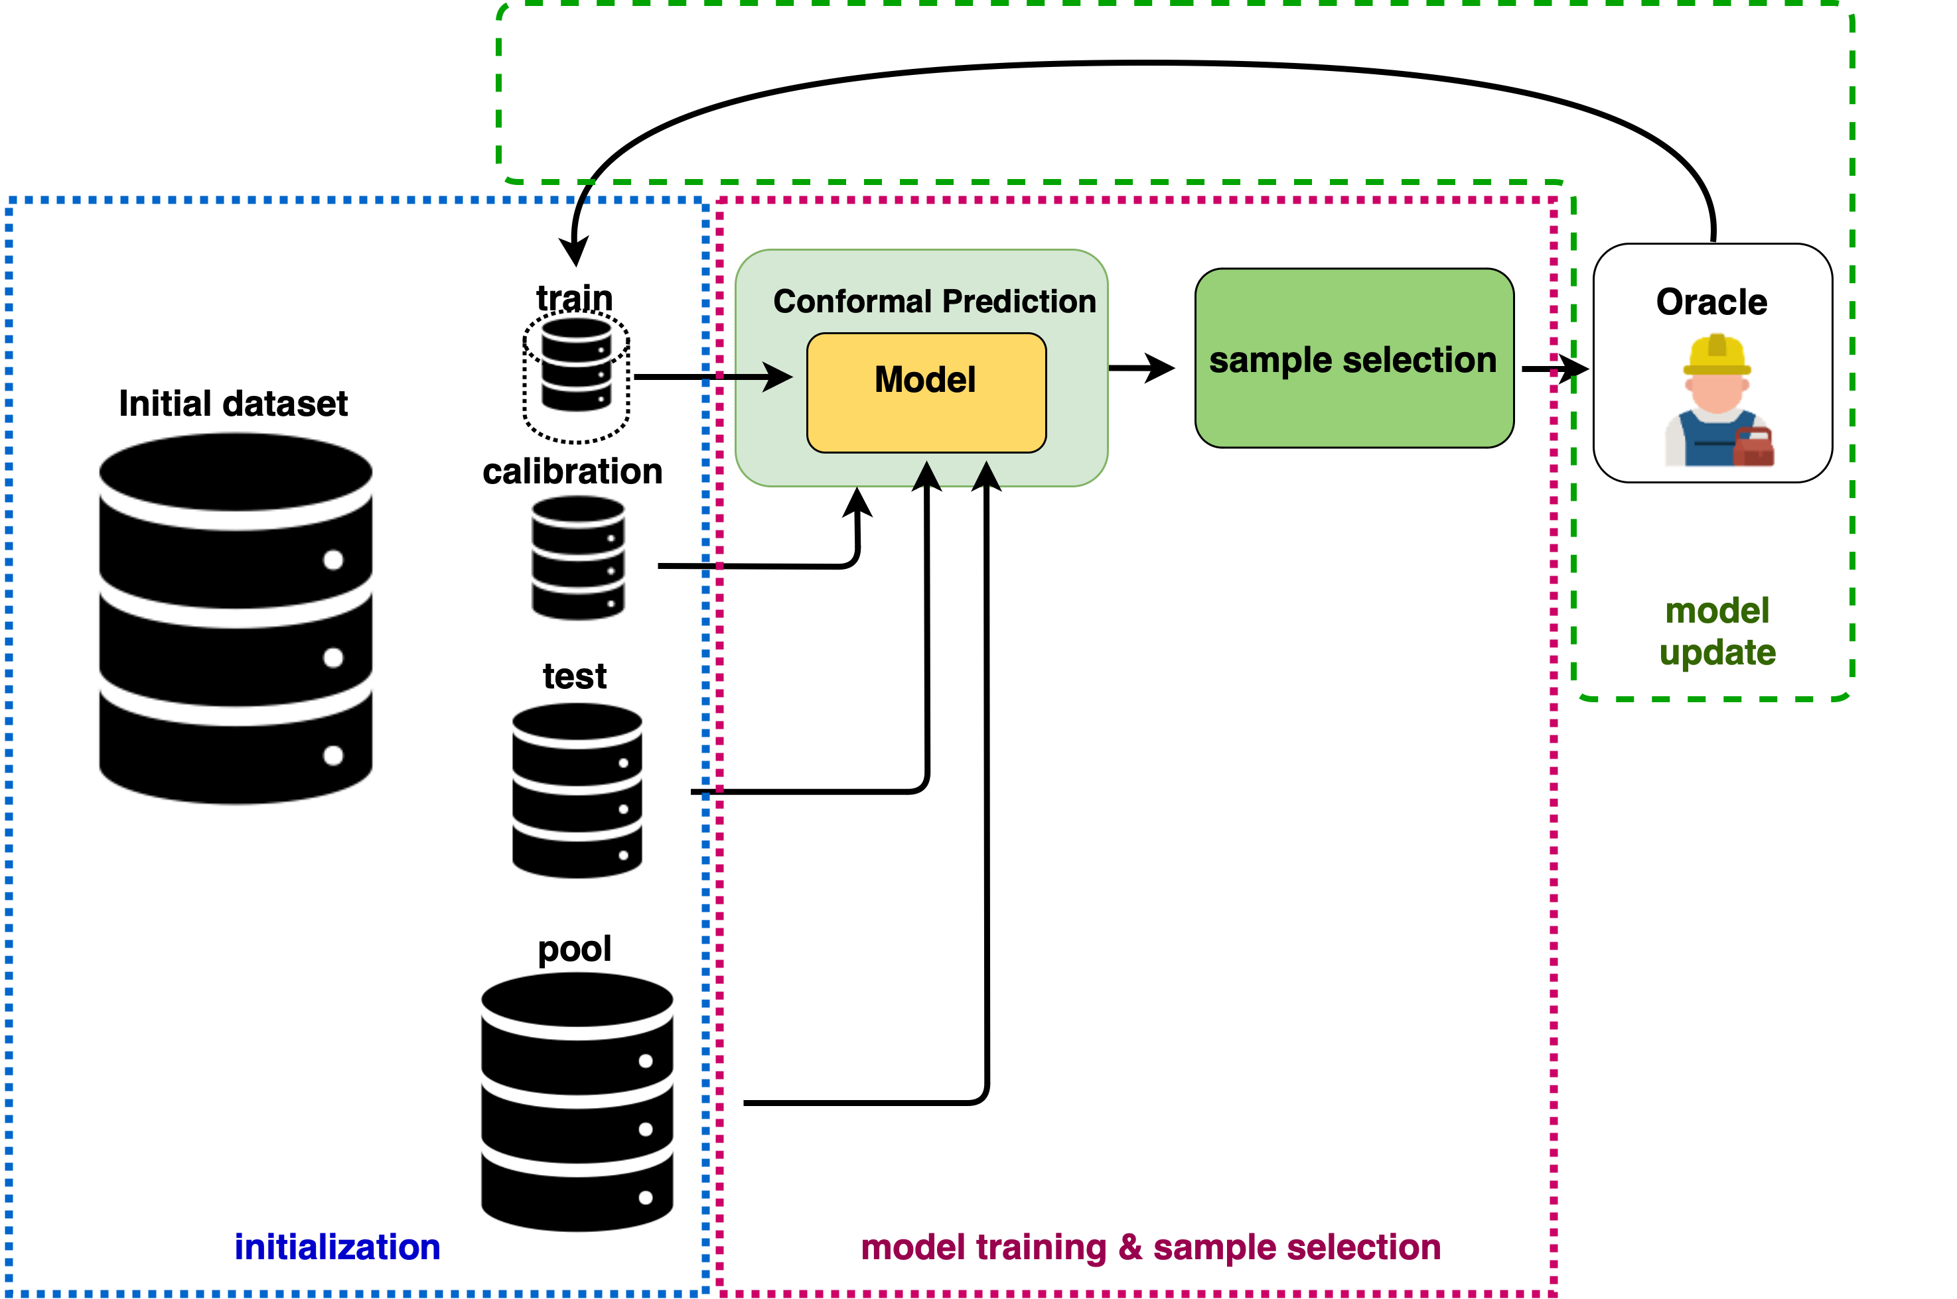
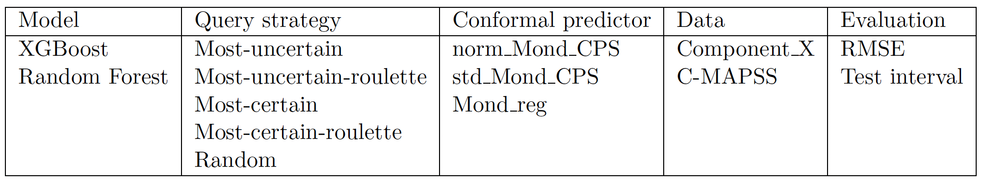
CoPAL Framework
Crepes package
Notes:
We get the max and min of the intervals and then we have the prediction intervals for the pool samples

Slide 5

Experiments on SCANIA’s Component X data

Slide 6
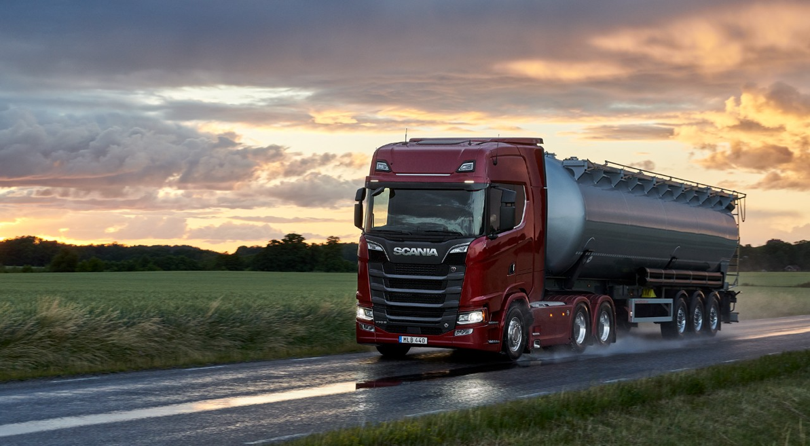

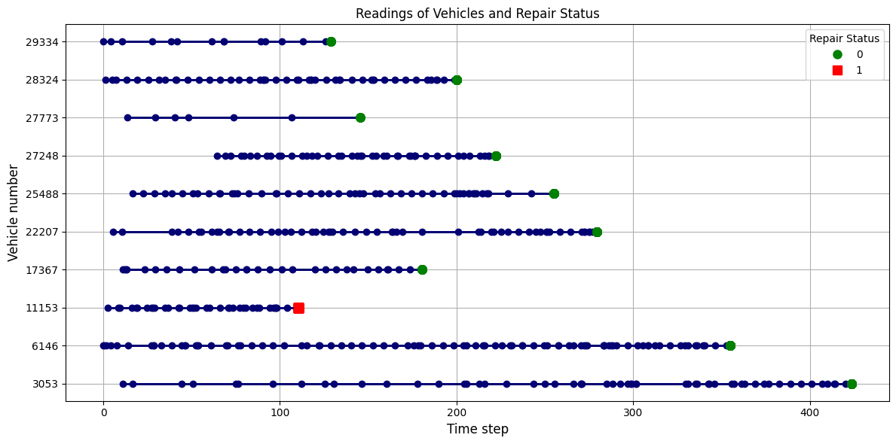
SCANIA’s Component X data:
Download data here:
Key Features:
Free & Publicly Available
Real-world data collected from an anonymized engine component (Component X) of 33’000 trucks
Size: 1.5 GB
Multivariate Time Series
Rich and Detailed:
  Operational readouts
  Time-to-failure
  Specifications
Photo: https://www.scania.com/se/sv/home.html

Slide 7
Experimental setup for Component X:
  Initialization:
  Train: 22 vehicles (973 readouts in total)
  Pool: 1362 vehicles
  Calibration: 320 vehicles
  Test: 567 vehicles
  Total: 2271
Feedback (Label/correct the labels of these 226 vehicles in each iteration)
Model update (remove the selected samples from the pool and add them to the train)
Model training:
XGBoost
RF
Sample selection:
(query strategy: Uncertainty sampling: select 226 more vehicles from the pool)
Most uncertain
Most uncertain roulette
Most certain
Most certain roulette
Random

Slide 8

Results on SCANIA’s Component X data:

Slide 9
XGB, norm_Mond_CPS
XGB, std_Mond_CPS
XGB, Mond_reg
XGB, norm_Mond_CPS
RF, norm_Mond_CPS
RF, std_Mond_CPS
RF, Mond_reg

Slide 10
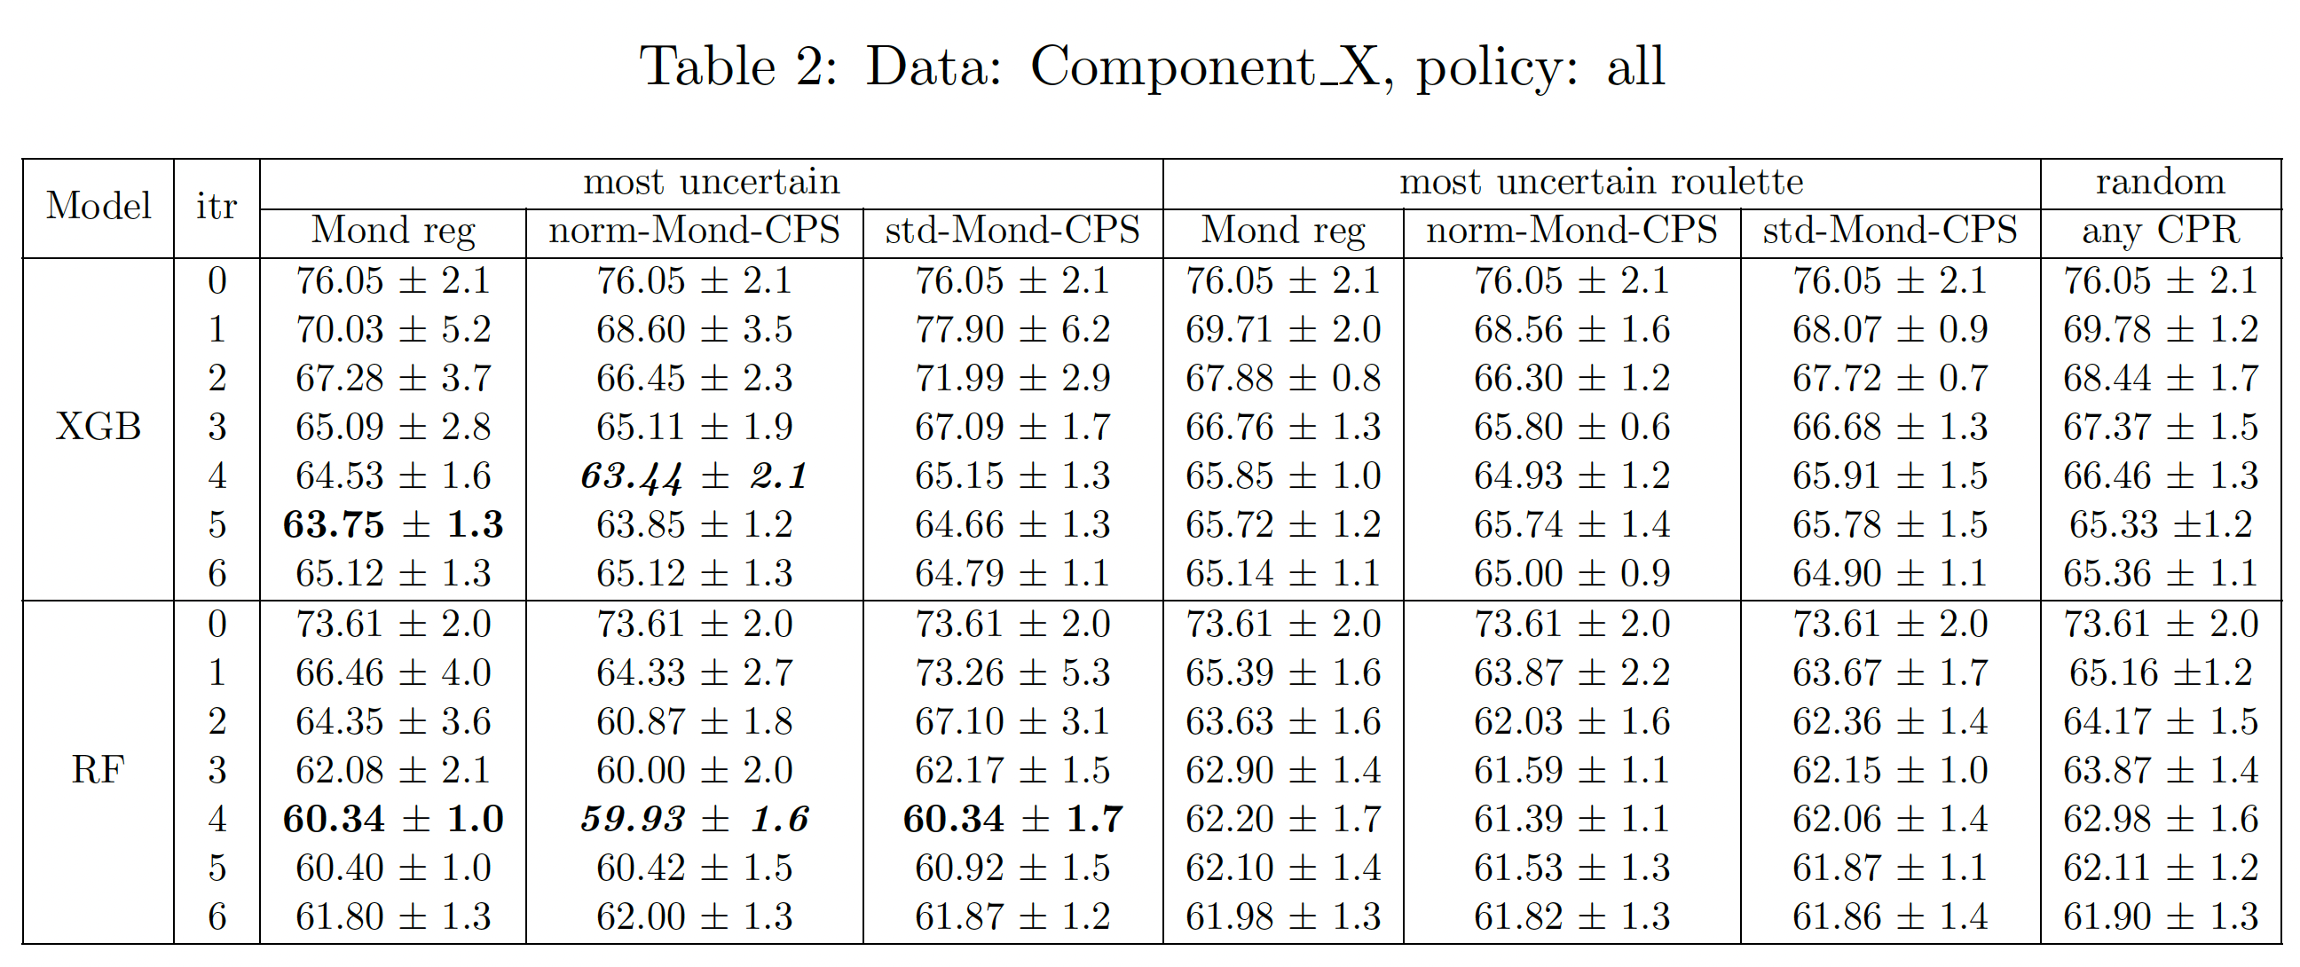
Experiments on Scania’s Component X data
XGB: 13.06 units, 16% improvement
RF: 13.68 units, 17% improvement

Slide 11
Test prediction intervals:
RF, norm-Mond-CPS
RF, std-Mond-CPS

Slide 12
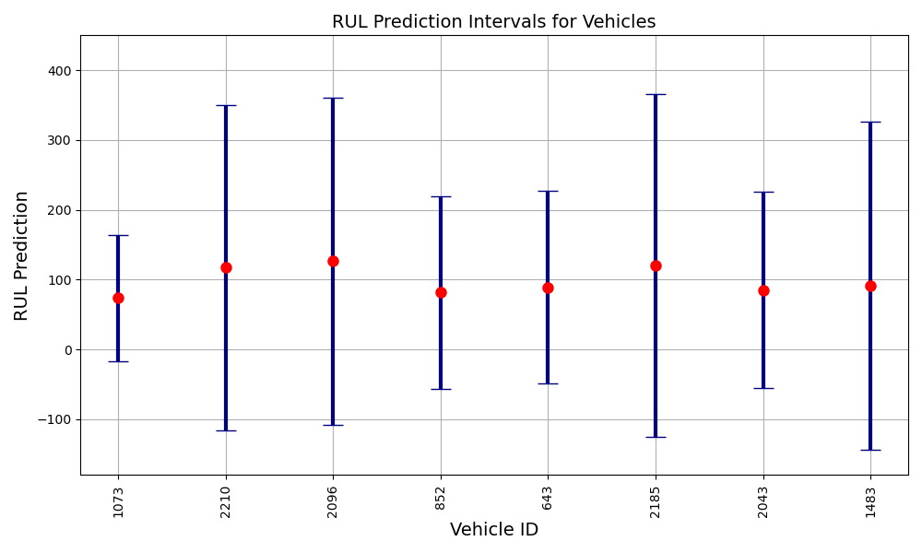
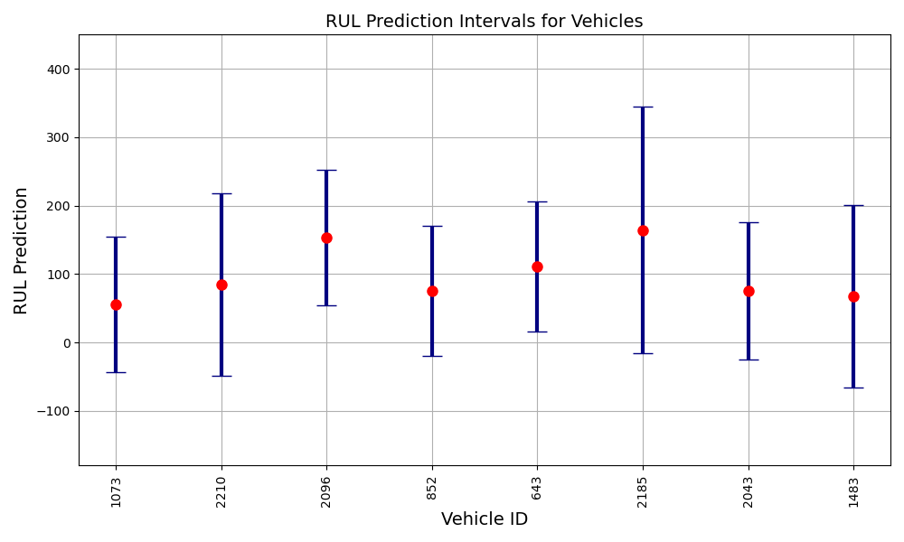
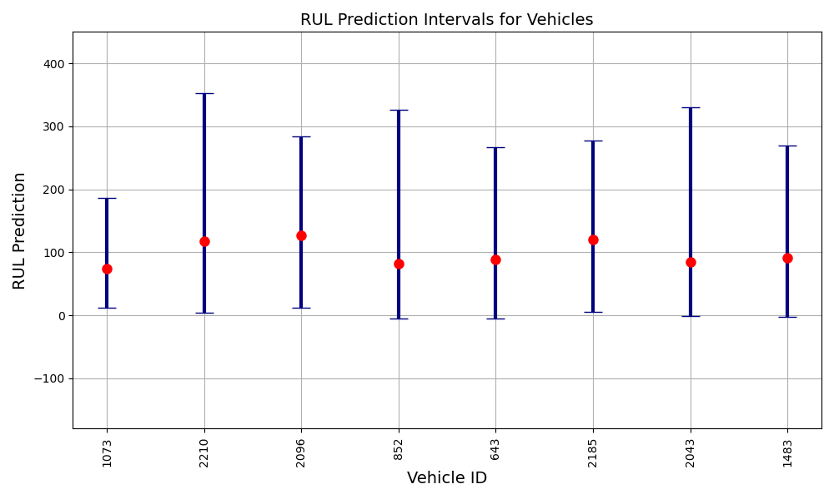
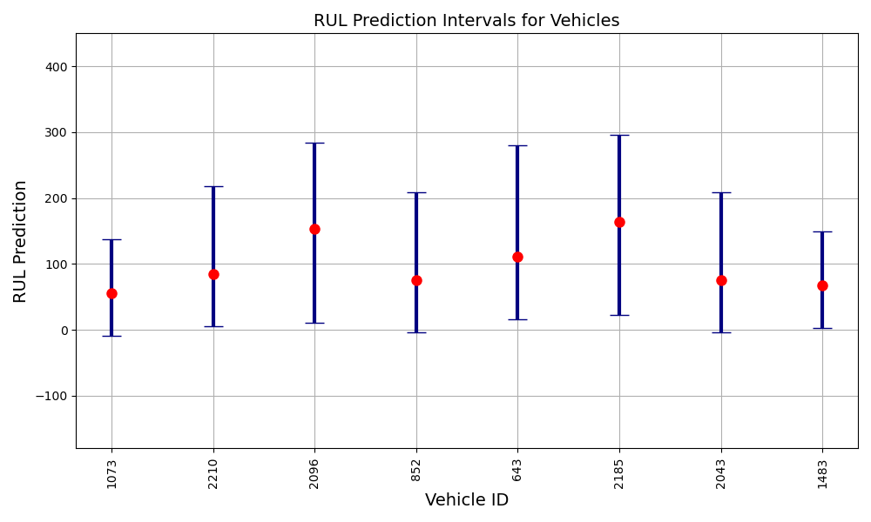
Test sample’s prediction intervals after iterations of AL
Mondrian regressor (first iteration)
Mondrian regressor (last iteration)
Std-Mond-CPS (first iteration)
Std-Mond-CPS (last iteration)

Slide 13

Experiments on C-MAPSS data

Slide 14
C-MAPSS data:
Synthetic data from NASA Turbofan Jet Engines simulation
Publicly available
Multivariate time series
Includes multiple subsets (FD001 to FD004), each corresponding to different operating conditions and engine fault modes.
It includes sensor measurements collected from various sensors installed on the engine
Includes information about the engine’s health and remaining useful life.

Slide 15
Experimental setup for C-MAPSS data:
  Initialization:
  Train: 1 vehicle (209 readouts in total)
  Pool: 60 vehicles
  Calibration: 14 vehicles
  Test: 25 vehicles
  Total: 100
Feedback (Label/correct the labels of these 9 vehicles in each iteration)
Model update (remove the selected samples from the pool and add them to the train)
Model training:
XGBoost
RF
Sample selection:
(query strategy: Uncertainty sampling: select 9 more vehicles from the pool)
Most uncertain
Most uncertain roulette
Most certain
Most certain roulette
Random

Slide 16
Results on C-MAPSS (FD001) data:

Slide 17
XGB, norm_Mond_CPS
XGB, std_Mond_CPS
XGB, Mond_reg
RF, norm_Mond_CPS
RF, std_Mond_CPS
RF, Mond_reg

Slide 18
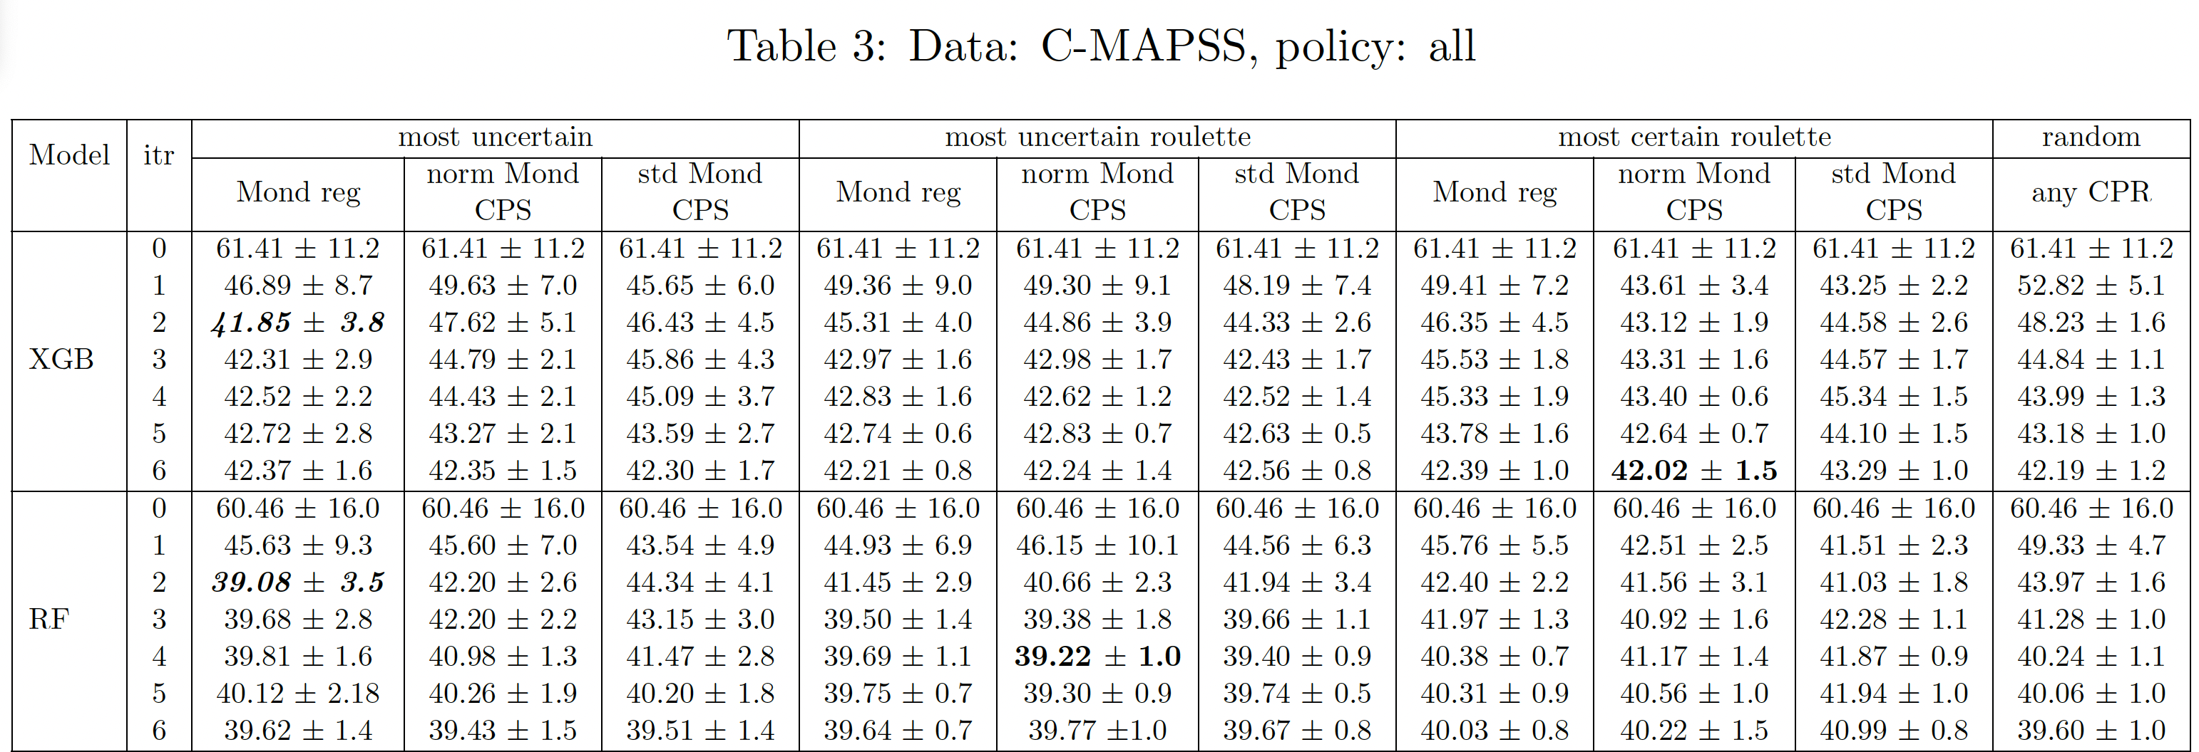
Experiments on C-MAPSS data
XGB: 19.56 units, 31% improvements.
RF: 21.38 units, 35% improvements.

Slide 19
Test samples’ prediction intervals:
RF, Mond-reg
RF, norm-Mond-CPS

Slide 20
To conclude:
Future study:
We propose the CoPAL algorithm that integrates Conformal Prediction in the Active Learning framework for regression tasks.
We applied it to a real-world scenario focused on predictive maintenance, i.e., estimating a vehicle component's remaining useful life (RUL).
We illustrate the benefits of the CoPAL algorithm on Predictive Maintenance problems using real-world/synthetic data.
Model and application agnostic (other than PdM)
It can be used with all types of data
CoPAL algorithm could be extended to incorporate survival analysis.
Exploring different query strategy methods beyond uncertainty-based sampling in active learning.
Applying the CoPAL algorithm to domains other than predictive maintenance, such as the medical field, could be a valuable direction for future research.

Slide 21

Thanks! Questions?

